Slide 1
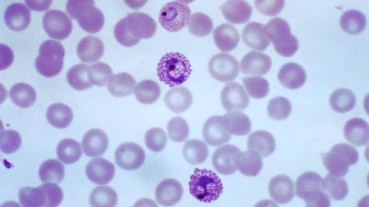
MALARIAL PARASITES DETECTION AND CLEARANCE RATES – BAYESIAN HIERARCHICAL REGRESSION MODELLING
MSDS DATA SCIENCE PRACTICUM 1 - OLUFEMI BABALOLA ​

Slide 2
INTRODUCTION
Malaria is a life-threatening mosquito-borne blood disease. It is rampant in under developed countries and originates from the infected Anopheles mosquito that transmits a parasite. This enters the victim’s blood system and into their liver where the parasite reproduces. The ending result is the victim getting a high fever that entails shaking chills and pain or in worst case scenarios, coma and death. With the rising epidemic of malaria, it has been a concern within the health care industry on the parasite resistance to antimalaria drugs and the clearance rates.
According to the World Health Organization (WHO), an estimated 3.2 billion people are at risk of malaria which has made this mosquito-borne infection a critical public health problem. There was an estimated 438,000 people that died from malaria in 2015 and 620,000 in 2017.

Slide 3
PURPOSE OF THE PROJECT
DETECTION OF MALARIA PARASITES AND CLEARANCE RATES
Resistance to anti-malarial drugs has led malaria researchers to investigate what covariates (parasite and host factors) are associated with resistance. In this regard, investigation of how covariates impact malaria parasites clearance is often performed using a two-stage approach in which the WWARN Parasite Clearance Estimator or PCE is used to estimate parasite clearance rates and then the estimated parasite clearance is regressed on the covariates. However, the recently developed Bayesian Clearance Estimator instead leads to more accurate results for hierarchical regression modelling which motivated the authors to implement the method as an R package, called “bhrcr”.

Slide 4



THE BHRCR PACKAGE
Provides tools for calculating, analyzing, and visualizing parasite clearance rates in the presence of "lag" and "tail" phases.
LIBRARY
Performs Bayesian hierarchical regression on the clearance rates.
DATA MODELING AND REGRESSION
Takes serial measurements of a response on the patient (e.g., parasite densities after artemisinin administration) over time.
PROGRAM

Slide 5



Bayesian hierarchical regression AND DATA ANALYSIS
Principal function in the bhrcr package that analyzes the input data set in the Bayesian framework.
clearanceEstimatorBayes
Bayesian hierarchical model
Estimate both clearance rates and the impact of patient level covariates on them, while accounting for lag phase, tail phase, and censored observations
Markov chain Monte Carlo (MCMC)
Generates a MC sample which is correlated with nearby samples. Thus, if uncorrelated samples are required for interference, one can thin the resulting chain (after the burn-in period) by only taking every n-th value which is called thinning.

Slide 6
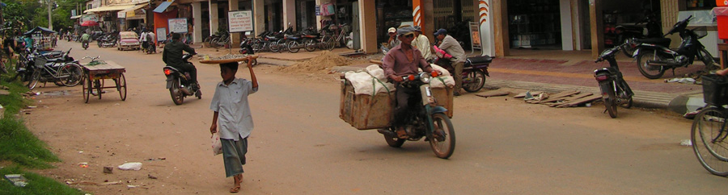

The data is recorded from the pursat province of cambodia
Profiles of 110 patients, along with individual level covariates, measured in 2009 and 2010.

Slide 7
COVARIATES DATA DESCRIPTION
Sex: A factor variable with two levels F and M​
agegroup: 21+ (21 years of age or older), or 21− (younger than 21 years)​
vvkv: whether or not the patient was from the Veal Veng district or Kranvanh district in Pursat, Cambodia​
HbE: the number of alleles of Haemoglobin E variant​
athal: the number of alleles of thalassaemia variant​
g6pd: the number of alleles of glucose-6-phosphate dehydrogenase deficient variant​
lnPf0: Log initial parasite density​
year2010: TRUE if 2010, FALSE if 2009​
group: 1 if parasite group 1, 0 if parasite group 2

Slide 8
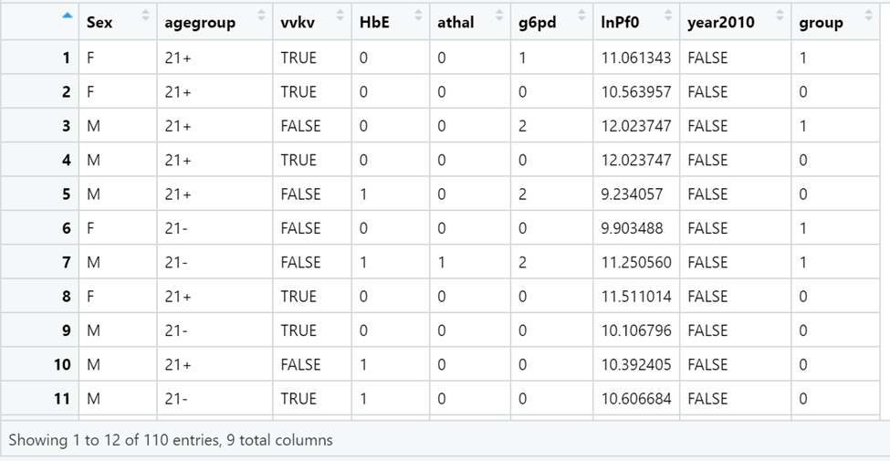
THE PURSAT COVARIATES
covariates: a data frame (with no missing values), ordered according to patients’ order in data and contains individual level covariates. Additionally, it concludes that the covariates in the analysis can increase statistical power and improve precision of the treatment effect.

Slide 9
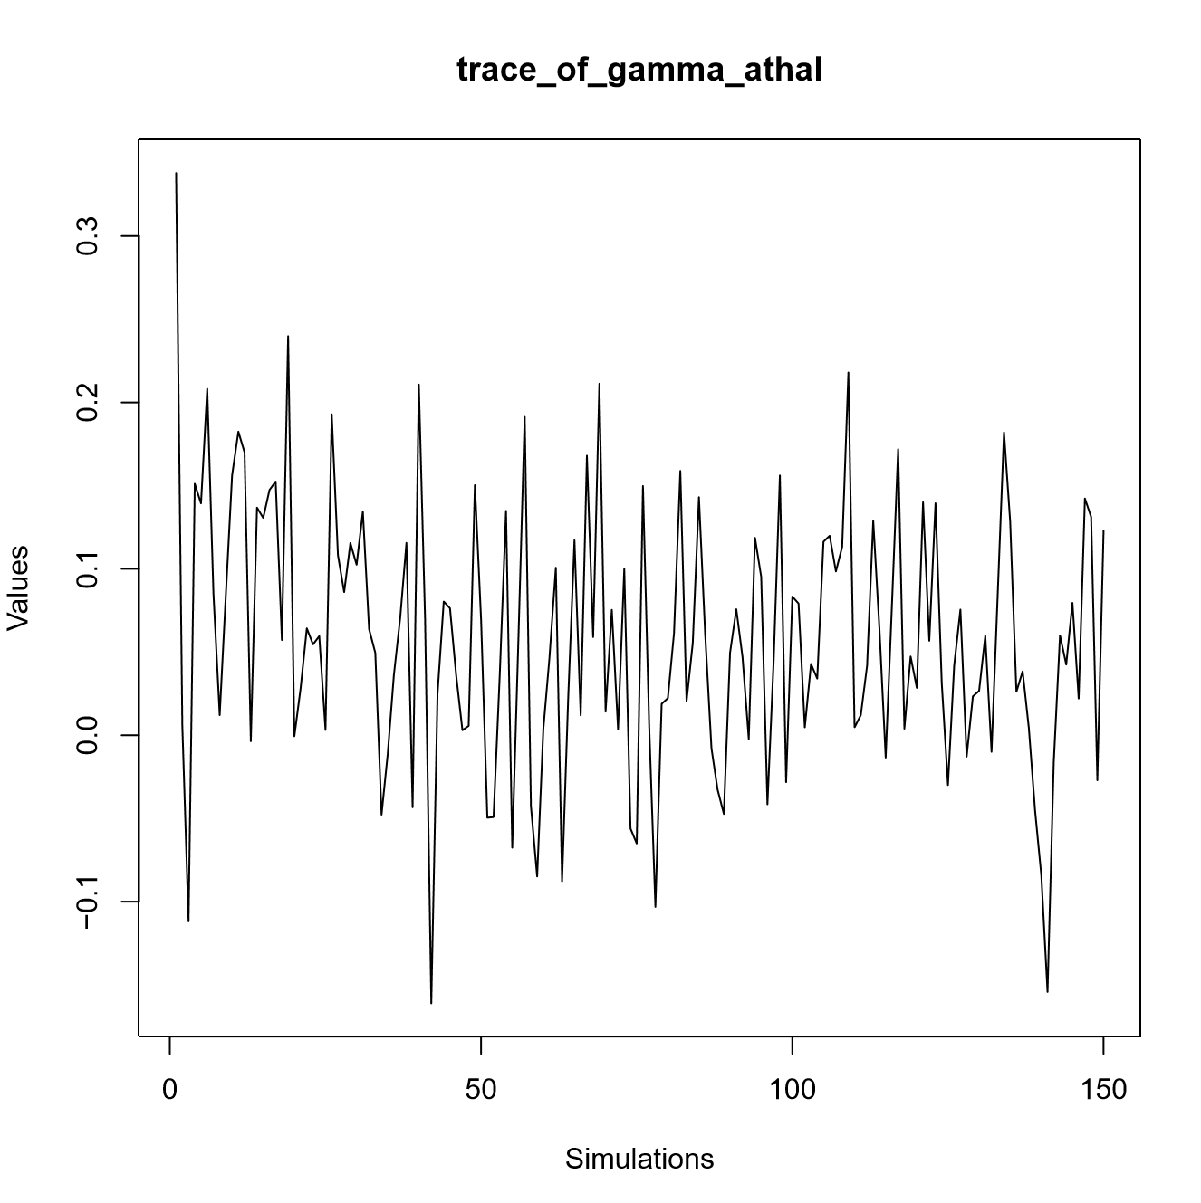
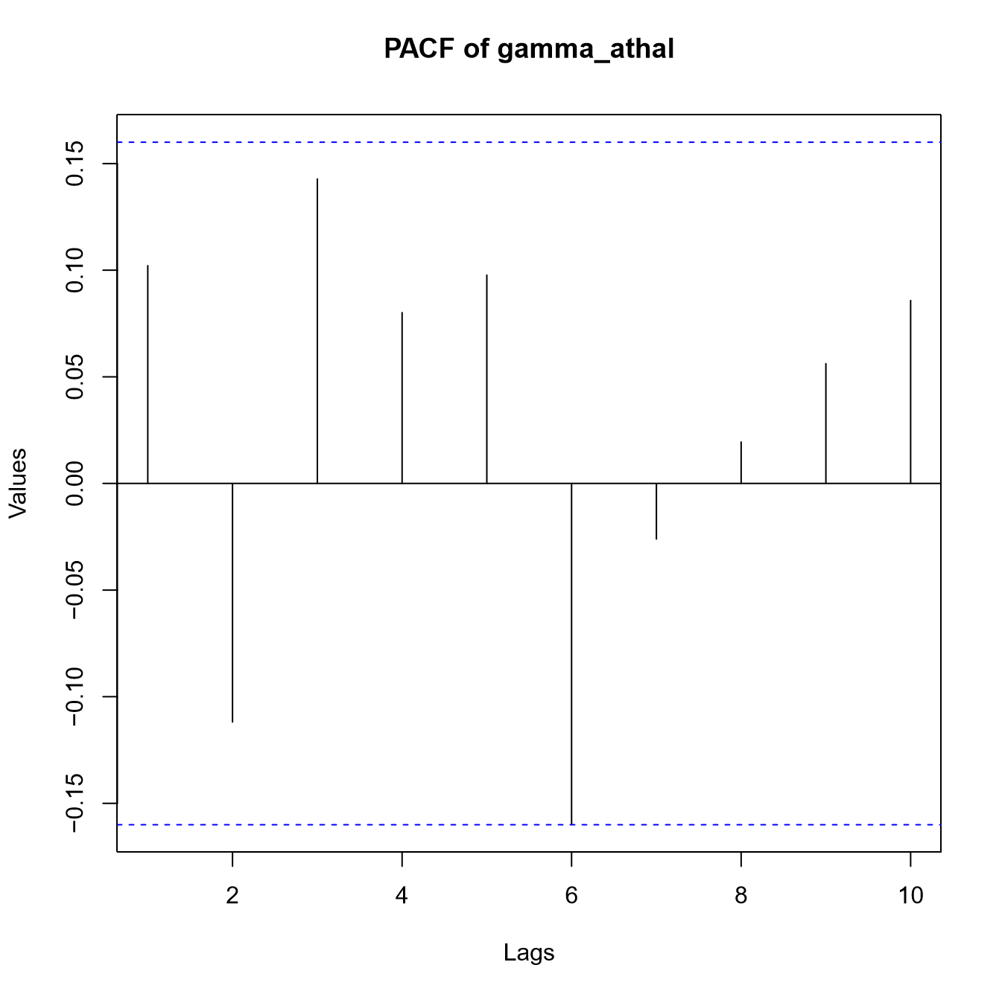
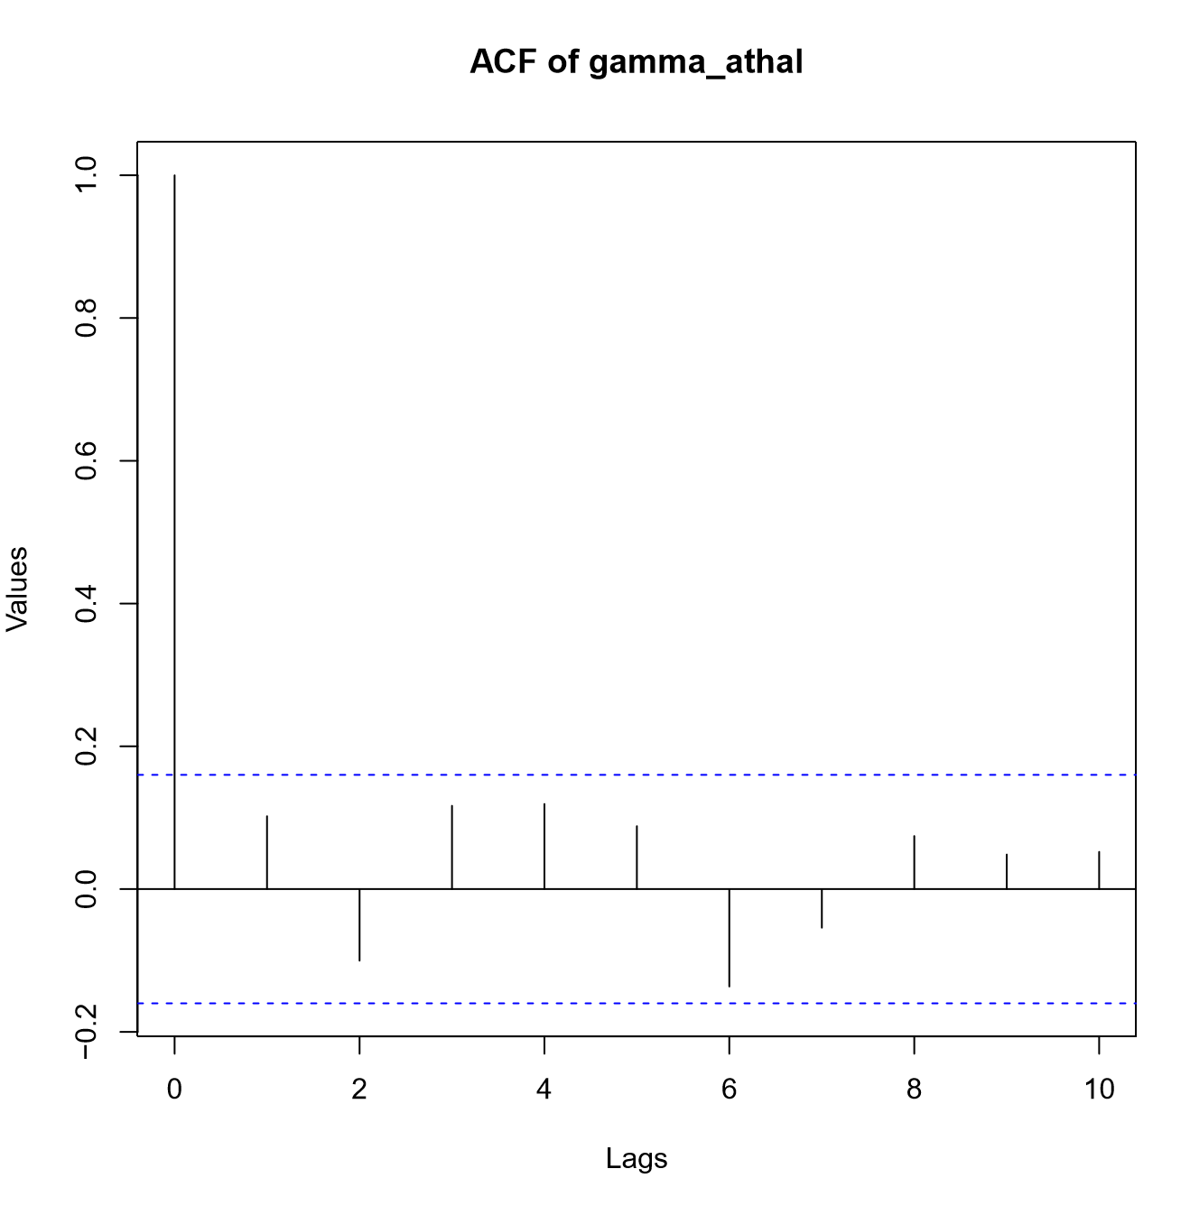
Diagnostic of the gamma_athal
Provides diagnostic analysis such as trace plots, ACF (auto-correlation function) and PACF (partial auto-correlation function) plots for some important parameters in the MCMC process of the Gibbs sampling.
These diagnostic plots help to assess whether it is plausible that the MCMC process has reached stationarity and has been thinned sufficiently.

Slide 10
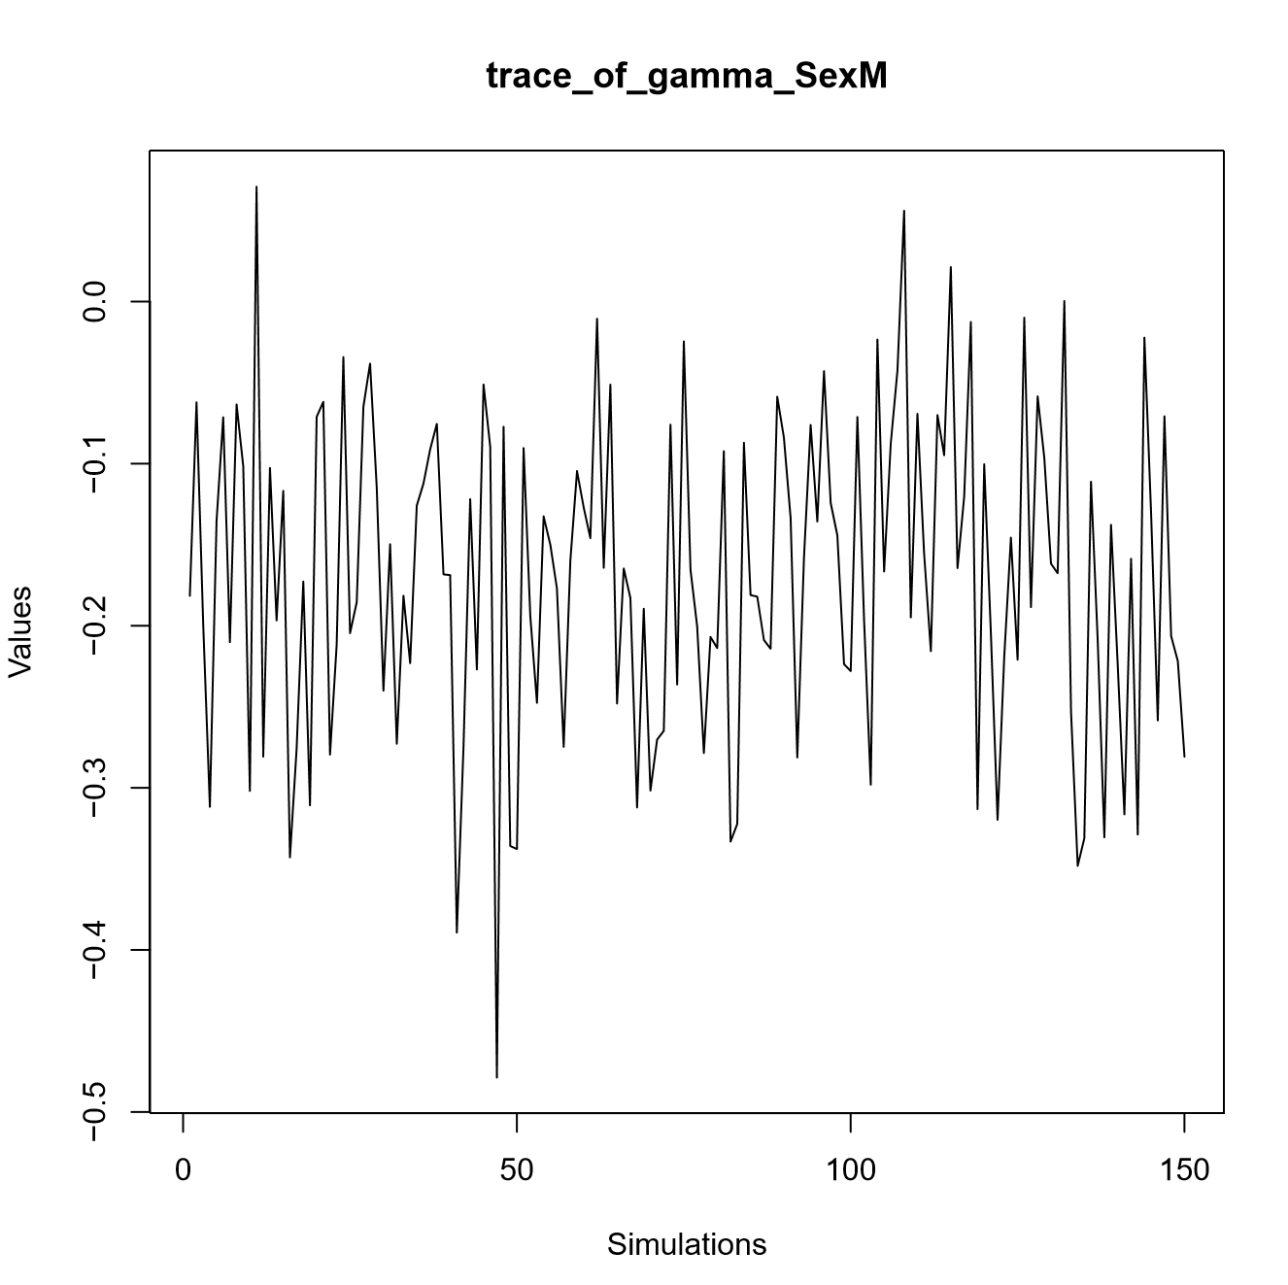
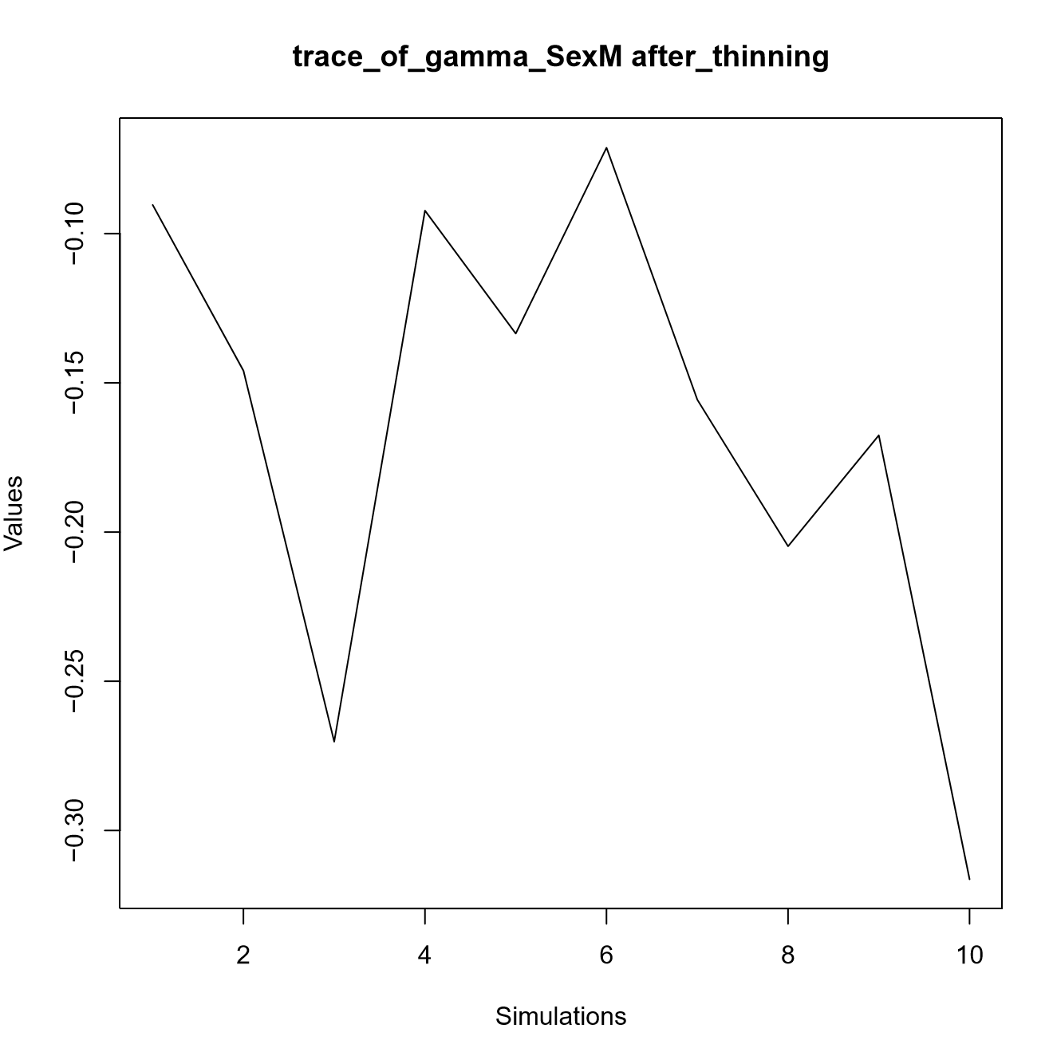
Diagnostic of the male gender pre and post thinning

Slide 11
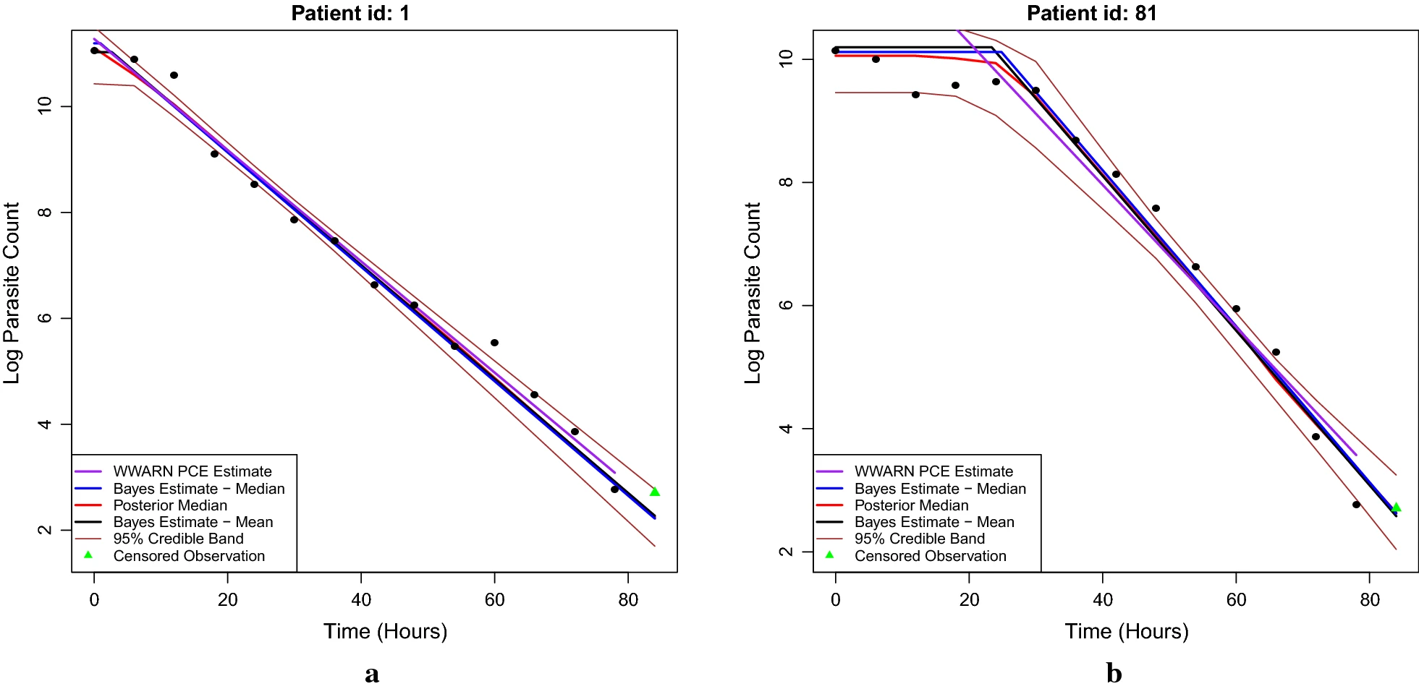
The profile of patient 1 is identified as only having a decay phase. The profile of patient 81 is identified as having a significant lag phase before the decay occurs. The brown lines characterize the point-wise 95% credible intervals of the posterior samples. The solid black and blue lines represent, respectively, the posterior mean and median clearance rates from the Bayesian procedure. The solid red line is the posterior median curve and the purple line is the fit given by the WWARN PCE method. The triangles are censored observations due to the detection limit.

Slide 12
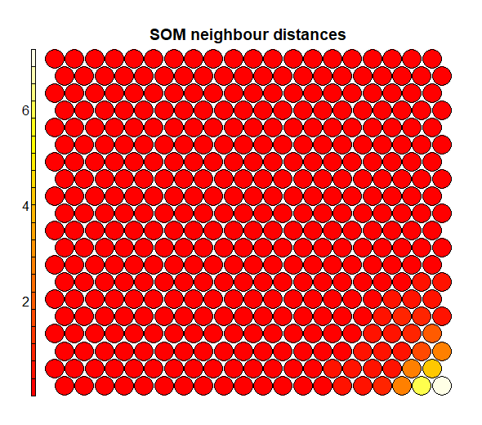
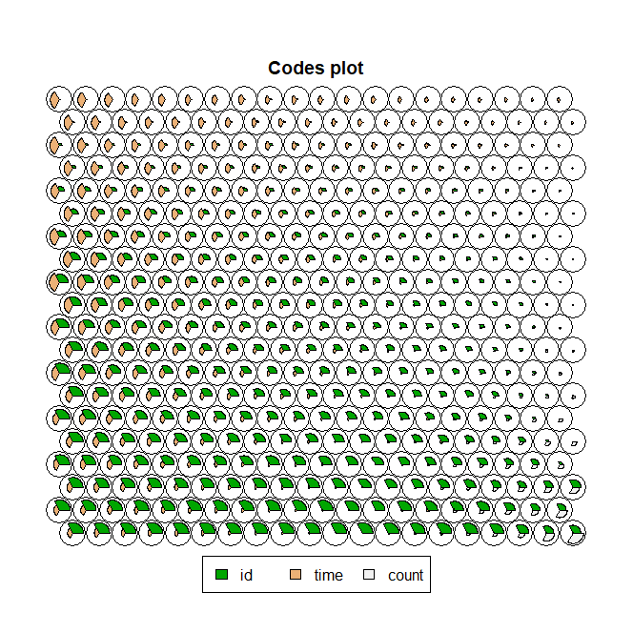
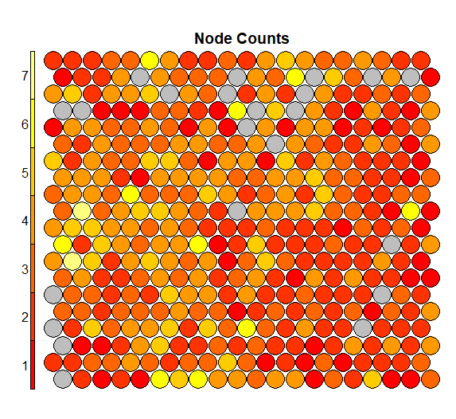
SOM Model allows us to scale the data to analyze the variables
The kohonen package function is to train self-organizing maps (SOMs). Also, it allows for interrogation of the maps and supports prediction using trained maps.

Slide 13
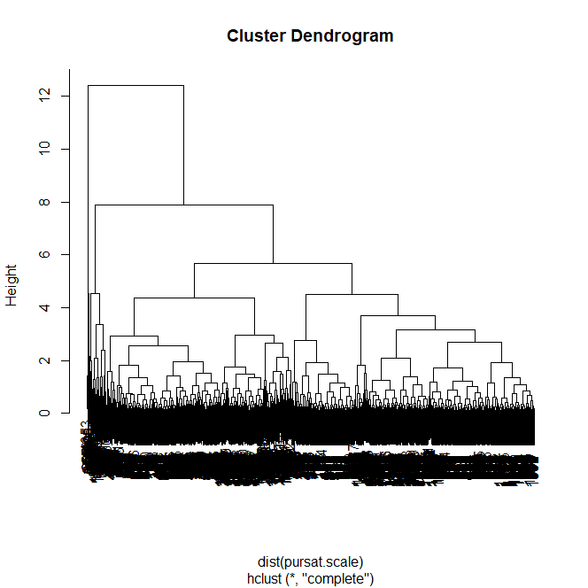
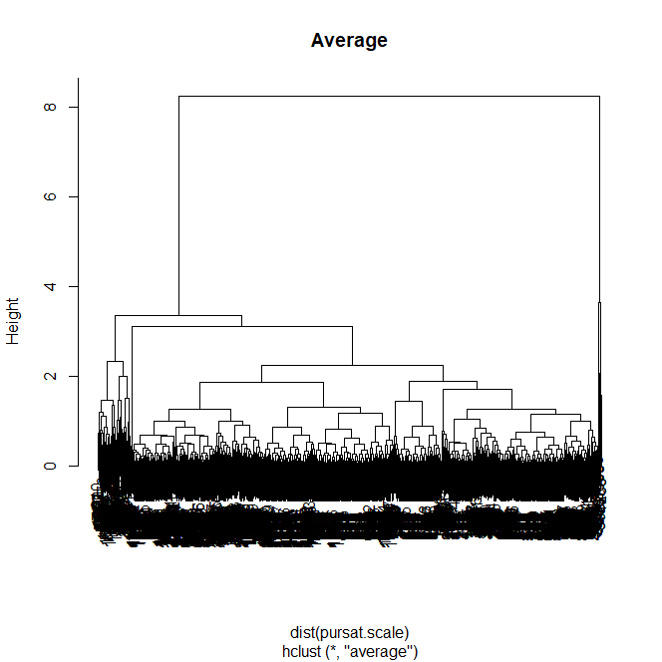

Dendrogram of the best clustering method

Slide 14
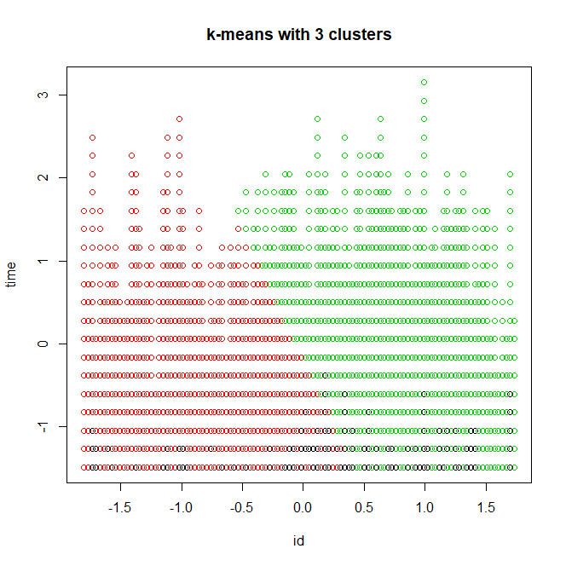
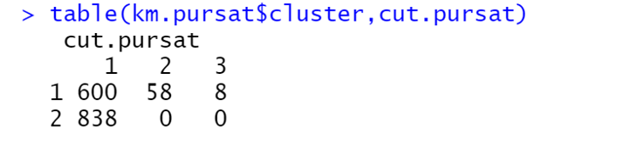
CONCLUSION

